Slide 1

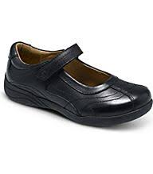
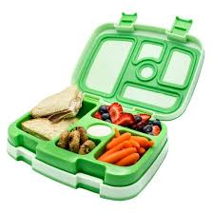
 | M | T | W | T | F | S
Notes:
Exercise, Kitchen, Bathroom, Hall, Sweeping

